Slide 1
From Excel to Excellent
Basic GUI Controls

Slide 2
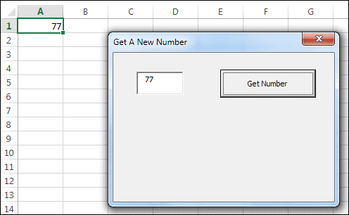

User Forms in VBA
Example 1: Create a user form that get a number from users and store the number in an active cell.
And launch the Form from a Button on a Spreadsheet

Slide 3
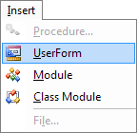
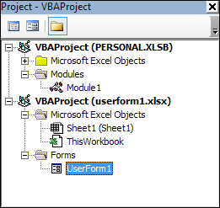
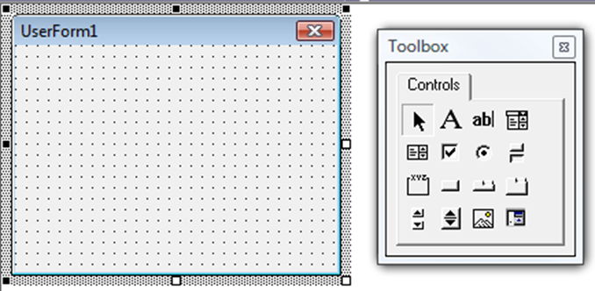
User Forms in VBA
One of the best tools VBA for Excel offers to help in this communication with the user is user forms.
  Insert > User Form from the menu in the VBE
  Insert icon as seen when inserting modules
You will then see a blank form and the Control Toolbox.

Slide 4
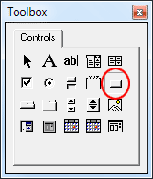
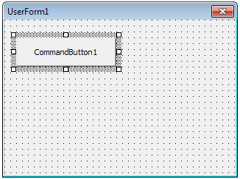
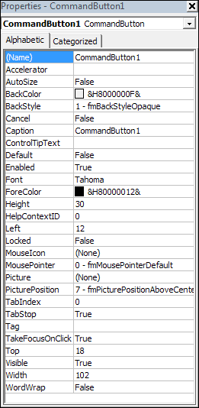

Slide 5
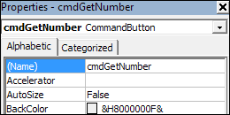
Adding Controls to a User Form
The first property in the Properties area is Name. The default value for the Name of a button isCommandButton, then a number. Click inside of where it says CommandButton1. Now press the backspace key on your keyboard to delete it. Type a new Name property. Call it cmdGetNumber. You should see the top of the Properties area change to this:
The internal name of the button is now cmdGetNumber.

Slide 6
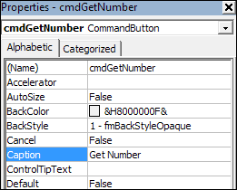

Adding Controls to a User Form
The text on a button is a different property. With your button still selected, locate the Caption property:
The text on the button on your form will change to this:

Slide 7
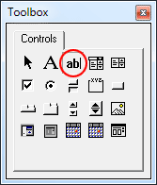
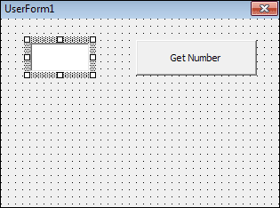
Adding Controls to a User Form
To add a text box to your form, click the TextBox item in the toolbox:
Now draw one out on your form. Change the Name property of the text box to txtValue. Change the Width property to 50 and the Height to 25. Set the Top property to 20 and the Left property to 25. Your form should now look like this:

Slide 8
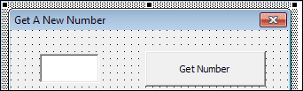
Adding Controls to a User Form
If you have a look in the top left of the form, you'll see the text UserForm1. This is the form Caption. You can change this to anything you like. Click anywhere on the grey from that is not a control (button and text box). With the form highlighted, locate the Caption property in the Properties area. Delete UserForm1 and type Get A New Number in its place. The top of your form will then change to this:

Slide 9
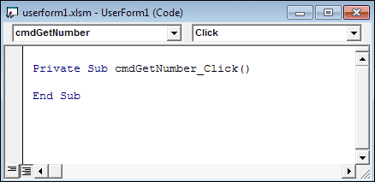
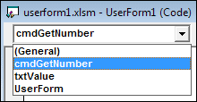
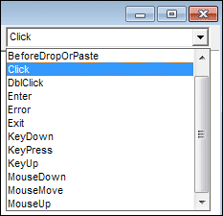
Add the Code for the User Form Button
Simply double click the button on the form. When you do, you'll see this:

Slide 10
Add the Code for the User Form Button
Private Sub cmdGetNumber_Click()
  ActiveCell.Value = txtValue.Text
  Unload Me
End Sub

Slide 11
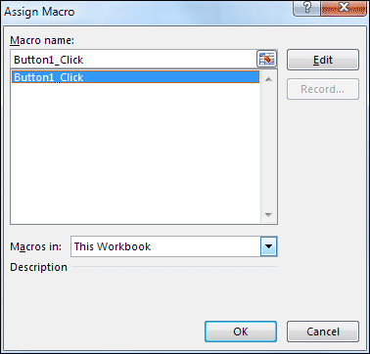
Launching your User Form
Launch a Form from a Button on a Spreadsheet
Go back to your spreadsheet and add a new button. When the Assign Macro dialogue box appears, select Button1_Click:
When you click OK, you should see a coding window appear.

Slide 12
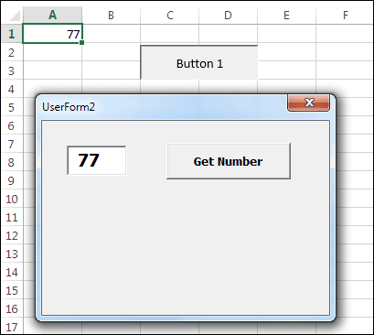
Launching your User Form
To launch a form, you need the Show method after the name of your form:
Sub Button1_Click( )
  UserForm1.Show
End Sub
Add the line to your own Button1_Click Sub.
Now go back to your spreadsheet. Click your button and you should see your form appear:

Slide 13
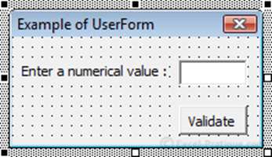
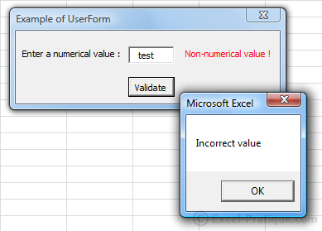
Label, TextBox and CommandButton
Example 2: Create a user form that get a number from users and store the number in cell A1.
If users enter a nonnumeric value, “Non-numerical value !” message is promptly shown in the form. And if users click button “Validate”, a message “Incorrect value” in Msgbox is shown.

Slide 14

Label, TextBox and CommandButton
Select a button and an event Click :
Private Sub CommandButton_validate_Click()
Range("A1") = Textbox_number.Value
'Textbox_number is the name of the text box
'Value is the property that contains the value of the text box
Unload Me
'Unload closes the UserForm
'We are using Me in place of the name of the UserForm (because this code is within the UserForm that we want to close)
End Sub
The value will now be saved in cell A1 before the closing of the UserForm.

Slide 15
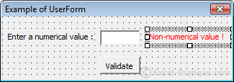
Label, TextBox and CommandButton
Add a second Label and edit the following properties : Caption, Forecolor (color : red) and Visible (False, to hide the control by default) :
Now let's add an event that will be fired when the value of the text box is changed, which will display an error message if the value is not numerical.
Private Sub Textbox_number_Change()
If IsNumeric(Textbox_number.Value) Then 'IF numerical value ...
Label_error.Visible = False 'Label hidden
Else 'OTHERWISE ...
Label_error.Visible = True 'Label shown
End If
End Sub

Slide 16
Label, TextBox and CommandButton
We still need to prevent the validation of the form if the value is not numerical :
Private Sub CommandButton_validate_Click()
If IsNumeric(Textbox_number.Value) Then 'IF numerical value ...
Range("A1") = Textbox_number.Value 'Copy to A1
Unload Me 'Closing
Else 'OTHERWISE ...
MsgBox "Incorrect value"
End If
End Sub

Slide 17
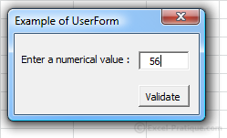
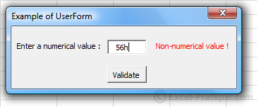
Label, TextBox and CommandButton
So as not to leave the right-hand side of the UserForm blank when there isn't any error, we can reduce its size by modifying the UserForm's Width property :
Private Sub Textbox_number_Change()
If IsNumeric(Textbox_number.Value) Then 'IF numerical value ...
Label_error.Visible = False 'Label hidden
Me.Width = 156 'UserForm Width
Else 'OTHERWISE ...
Label_error.Visible = True 'Label shown
Me.Width = 244 'UserForm Width
End If
End Sub

Slide 18
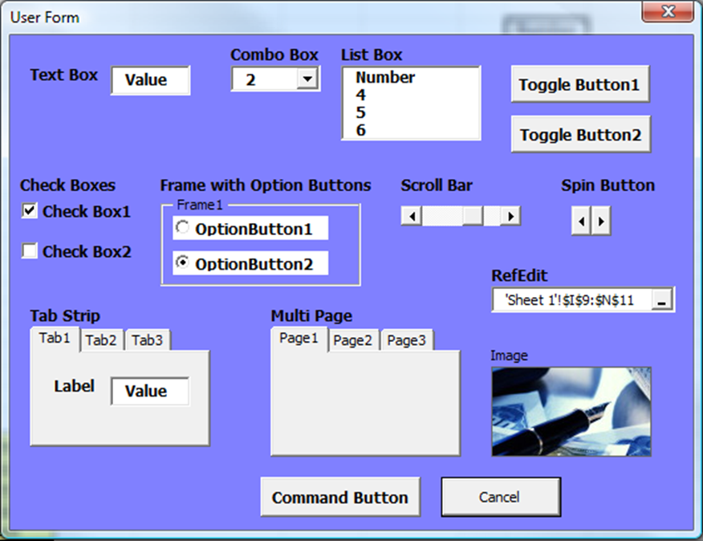
Possible User Form Controls

Slide 19
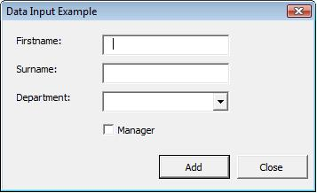
Input User Form
Example 3: You are to develop a simple user form input which adds record information into a worksheet.
Here's what we are going to achieve:
1. A user form will load from a button on a worksheet.
2. Users must complete Firstname, Surname and choose a Department (which will
be coded as mandatory fields).
3. When choosing the Add button it will append to the worksheet (called Data) and
always find the next available blank row to populate.
4. The form will remain open clearing the values ready for the next record input until the Close button is clicked.
5. A private macro (from the standard module) calls the user form (via its worksheet button).

Slide 20
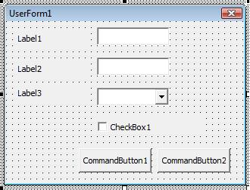
Input User Form
Create the user form canvas
Add a new blank user form the VBA Project.
In the VBE Editor, select Insert, UserForm.
Add the controls to the form
You need to add the following controls:
1. Two Command Buttons
2. Three Labels
3. Two TextBoxes
4. One ComboBox
5. One CheckBox

Slide 21
Input User Form
Setting the properties to each control
Control Property Value
CommandButton1 Name cmdAdd
Caption Add
Default True
Height 20
Width 60
Left 132
Top 114
TabIndex 4
CommandButton2 Name cmdClose
Caption Close
Cancel True
Height 20
Width 60
Left 198
Top 114
TabIndex 5

Slide 22
Input User Form
Setting the properties to each control
Control Property Value
Label1 Caption Firstname:
Height 18
Left 12
Top 12
Width 72
Label2 Caption Surname:
Height 18
Left 12
Top 36
Width 72
Label3 Caption Department:
Height 18
Left 12
Top 60
Width 72

Slide 23
Input User Form
Setting the properties to each control
Control Property Value
TextBox1 Name txtFName
Height 18
Left 84
Top 12
Width 108
TabIndex 0
TextBox2 Name txtSName
Height 18
Left 84
Top 36
Width 108
TabIndex 1
ComboBox1 Name cboDept
Height 18
Left 84
Top 60
Width 108
TabIndex 2

Slide 24
Input User Form
Setting the properties to each control
Control Property Value
CheckBox1 Name chkManager
Caption Manager
Height 18
Left 84
Top 84
Width 108
TabIndex 3
UserForm1 Name frmDataInput
Caption Data Input Example
Height 162.75
Width 267

Slide 25
Input User Form
Adding code to controls
The next step is start coding the form and it's important that you have at least named the controls you wish code as it will generate its own event signature.
Starting with the Close button which will simply close and end the user form.
Private Sub cmdClose_Click()
'close the form (itself)
Unload Me
End Sub
Unload Me refers to itself which is quick and easy. To explicitly close a user form, you refer to actual name of the form. Therefore, using Unload frmDataInput will be the same outcome.

Slide 26
Input User Form
Adding code to controls
Next, lets add code (run time) to populate the ComboBox control (cboDept) which will dynamically create four fixed options to choose from.
Private Sub UserForm_Initialize()
Me.cboDept.AddItem "Finance"
Me.cboDept.AddItem "Sales"
Me.cboDept.AddItem "Markerting"
Me.cboDept.AddItem "Human Resources"
Me.txtFName.SetFocus 'position the cursor in this control
End Sub
As the form loads (initialises), it adds four items to the cboDept control and then positions the cursor in txtFName ready for the user to start keying in data.
You could of course set this in the properties (RowSource) for cboDept instead which refers to range of cells in a worksheet.

Slide 27
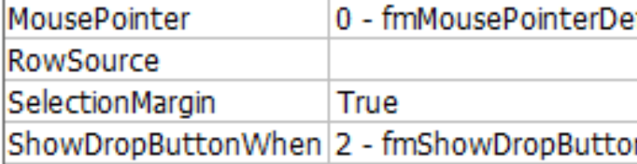
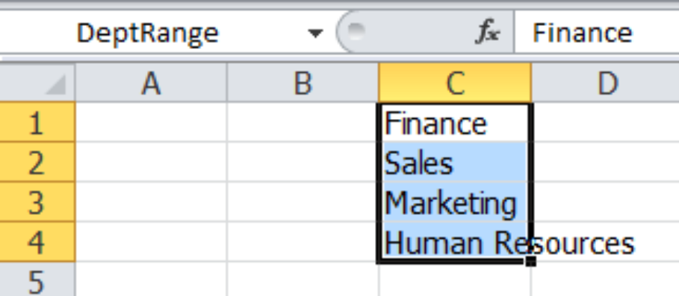
RowSource Property
RowSource can be set to DeptRange

Slide 28
Input User Form
Adding code to controls
The final piece of code is attached the cmdAdd button control so when users click this event, it will add the details to the worksheet (Data).
Private Sub cmdAdd_Click()
Dim i As Integer
'position cursor in the correct cell A2.
Range("A2").Select
i = 1 'set as the first ID
'validate first three controls have been entered...
If Me.txtFName.Text = Empty Then 'Firstname
MsgBox "Please enter firstname.", vbExclamation
Me.txtFName.SetFocus 'position cursor to try again
Exit Sub 'terminate here - why continue?
End If
If Me.txtSName.Text = Empty Then 'Surname
MsgBox "Please enter surname.", vbExclamation
Me.txtSName.SetFocus 'position cursor to try again
Exit Sub 'terminate here - why continue?
End If
If Me.cboDept.Text = Empty Then 'Department
MsgBox "Please choose a department.", vbExclamation
Me.cboDept.SetFocus 'position cursor to try again
Exit Sub 'terminate here - why continue?
End If

Slide 29
Input User Form
'if all the above are false (OK) then carry on.
'check to see the next available blank row start at cell A2...
Do Until ActiveCell.Value = Empty
ActiveCell.Offset(1, 0).Select 'move down 1 row
i = i + 1 'keep a count of the ID for later use
Loop
'Populate the new data values into the 'Data' worksheet.
ActiveCell.Value = i 'Next ID number
ActiveCell.Offset(0, 1).Value = Me.txtFName.Text 'set col B
ActiveCell.Offset(0, 2).Value = Me.txtSName.Text 'set col C
ActiveCell.Offset(0, 3).Value = Me.cboDept.Text 'set col D
'Is this person the manager?
If Me.chkManager.Value = True Then 'yes
ActiveCell.Offset(0, 4).Value = "Yes" 'Col E
Else
ActiveCell.Offset(0, 4).Value = "No" 'Col E
End If
'Clear down the values ready for the next record entry...
Me.txtFName.Text = Empty
Me.txtSName.Text = Empty
Me.cboDept.Text = Empty
Me.chkManager.Value = False
Me.txtFName.SetFocus 'positions the cursor for next record entry
End Sub

Slide 30
Input User Form
Create a worksheet button
In the worksheet in Excel, click the Developer tab from the Ribbon Bar and the Insert icon to drop-down a list of controls.
Choose the Button control icon from the Forms (section) and draw a button where you wish to place it (top row, frozen pane area).
In the assigning macro pop-up dialog box, click the New... button to create a module and signature and add the following code:
Sub Button1_Click()
'load the form
frmDataInput.Show
End Sub
Add the keyword Private before the Sub keyword to hide this from the macro dialog box.

Slide 31
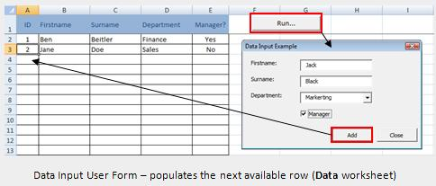
Input User Form
Create a worksheet button
This is how the form looks as it is called from the worksheet button control from the Dataworksheet.

Slide 32
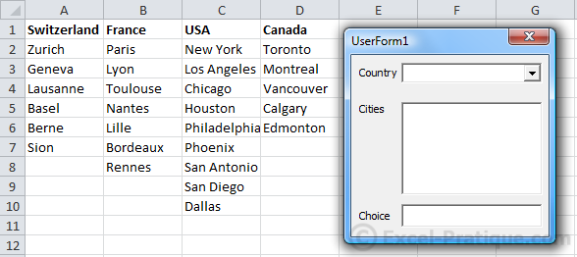
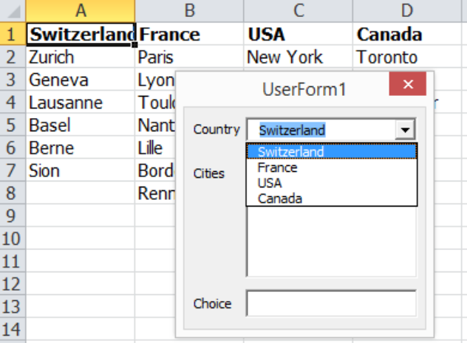
ComboBox and ListBox
Example 4: You are to develop the following user form of comboBox.xls.
When the UserForm is launched, we want the 4 countries to be loaded into the drop-down list (using the AddItem method) :

Slide 33
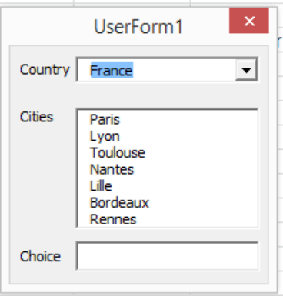
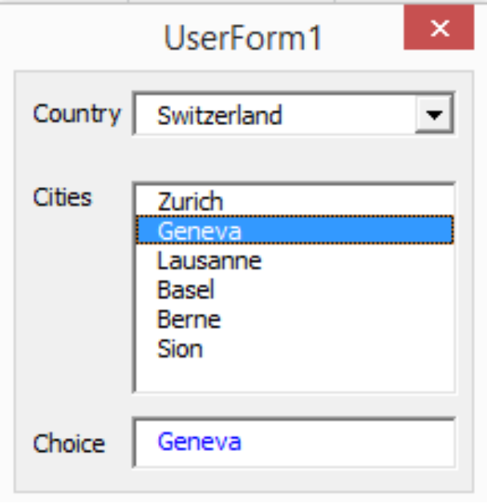
ComboBox and ListBox
Example 4 (Cont.):
When the value of the drop-down list changes, we want to add the cities in the chosen country.
When the city that is chosen, it will then be entered into the text area :

Slide 34
ComboBox and ListBox
When the UserForm is launched, we want the 4 countries to be loaded into the drop-down list (using the AddItem method) :
Private Sub UserForm_Initialize()
For i = 1 To 4 ' => to list the 4 countries
ComboBox_Country.AddItem Cells(1, i) 'Add the values of cells A1 through A4 using the loop
Next
End Sub

Slide 35
ComboBox and ListBox
When the value of the drop-down list changes, we want to add the cities in the chosen country using a loop.
In order to do this, we need the column number and the row number.
The property ListIndex contains the number of the selection in the drop-down list (unlike Value, which contains the value of the list item). Please note that ListIndex begins with the number 0.
Private Sub ComboBox_Country_Change()
ListBox_Cities.Clear
For i = 2 To Cells(1, ComboBox_Country.ListIndex + 1).End(xlDown).Row
ListBox_Cities.AddItem Cells(i, ComboBox_Country.ListIndex + 1)
Next
End Sub

Slide 36
ComboBox and ListBox
The city that is chosen will then be entered into the text area :
Private Sub ListBox_Cities_Click()
TextBox_Choice.Value = ListBox_Cities.Value
End Sub

Slide 37
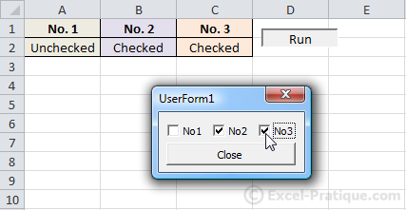
Checkboxes
Example 5: You are to develop the following user form of CheckBox.xls. The checkboxes start out unchecked when the UserForm is first opened.
When a checkbox is checked/unchecked, the value of the corresponding cell can be modified.

Slide 38
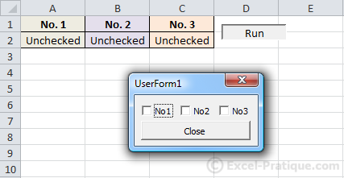
Checkboxes
When a checkbox is checked/unchecked, the value of the corresponding cell can be modified by using the Click event :
Private Sub CheckBox1_Click() 'Number 1
If CheckBox1.Value = True Then 'If checked ...
Range("A2") = "Checked"
Else 'If not checked ...
Range("A2") = "Unchecked"
End If
End Sub
Private Sub CheckBox2_Click() 'Number 2
If CheckBox2.Value = True Then 'If checked ...
Range("B2") = "Checked"
Else 'If not checked ...
Range("B2") = "Unchecked"
End If
End Sub
Private Sub CheckBox3_Click() 'Number 3
If CheckBox3.Value = True Then 'If checked ...
Range("C2") = "Checked"
Else 'If not checked ...
Range("C2") = "Unchecked"
End If
End Sub

Slide 39
Checkboxes
The checkboxes start out unchecked when the UserForm is first opened. To check the boxes when the value of the corresponding cell is "Checked", we'll run a test when the UserForm is activated, using UserForm_Initialize :
Private Sub UserForm_Initialize() 'Check box if "Checked"
If Range("A2") = "Checked" Then
CheckBox1.Value = True
End If
If Range("B2") = "Checked" Then
CheckBox2.Value = True
End If
If Range("C2") = "Checked" Then
CheckBox3.Value = True
End If
End Sub

Slide 40
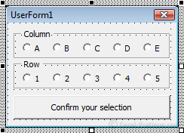
Frame and The Option Buttons
Example 6: You are to develop the following user form of optionButton.xls.
The user may only select one Option for Column and one Option for Row. Once users click the Button “Confirm your selection", the message “Cell chosen !” is shown in selected cell.

Slide 41
Frame and The Option Buttons
The user may only select one Option Button per "group", which is not the case with checkboxes.
To create a group, first insert a Frame and then OptionButton :

Slide 42
Frame and The Option Buttons
In order to know which option button was chosen, we're going to use a For Each loop that makes it possible to execute instructions for each object in an "object group" :
Private Sub CommandButton1_Click()
Dim column_value As String, row_value As String
'Loop for each Frame_column control
For Each column_button In Frame_column.Controls
'If the value of the control = True (then, if checked) ...
If column_button.Value Then
'The variable "column_value" takes the value of the button text
column_value = column_button.Caption
End If
Next
'Loop for the other frame
For Each row_button In Frame_row.Controls
If row_button.Value Then
row_value = row_button.Caption
End If
Next
Range(column_value & row_value) = "Cell chosen !"
Unload Me
End Sub

Slide 43
Frame and The Option Buttons
From the preceding code, we can modify it to be a modularity version as shown :
Private Function column_value()
'The function returns the value of the text for the button chosen (column_value)
For Each column_button In Frame_column.Controls
If column_button.Value Then
column_value = column_button.Caption
End If
Next
End Function
Private Function row_value()
'The function returns the value of the text for the button chosen (row_value)
For Each row_button In Frame_row.Controls
If row_button.Value Then
row_value = row_button.Caption
End If
Next
End Function
Private Sub CommandButton1_Click() 'Action that is taken when you click "Confirm your selection"
Range(column_value & row_value) = "Cell chosen !"
'column_value and row_value are the values returned by the functions
Unload Me
End Sub

Slide 44
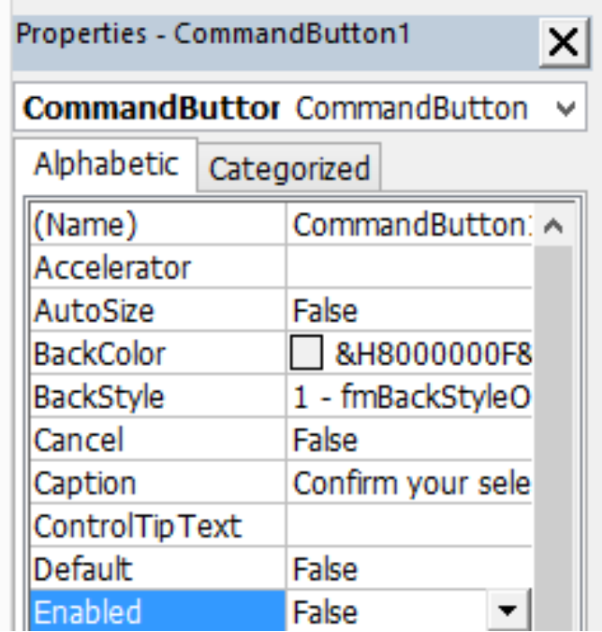
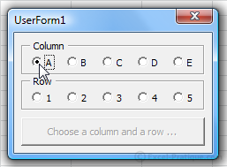
Frame and The Option Buttons
To avoid a bug, we need to check to make sure that the user has chosen correctly from the two sets of option buttons.
When the form is incomplete, the "Confirm" button will appear in gray (deactived). This is not the simplest solution, but it's a good example of why functions/procedures are useful within a UserForm.
Edit the Enabled property to deactivate the button :

Slide 45
Frame and The Option Buttons
Next, we have to create a procedure that verifies that the buttons have been checked correctly (by calling the two functions), and which will activate the button if necessary.
Private Sub activate_button()
'Activating the button if the condition is verified
If column_value <> "" And row_value <> "" Then
'column_value and row_value are the values returned by the functions
CommandButton1.Enabled = True
CommandButton1.Caption = "Confirm your selection"
End If
End Sub
Private Sub OptionButton11_Click()
activate_button 'Run the "activate_button" procedure
End Sub
Private Sub OptionButton12_Click()
activate_button
End Sub
Private Sub OptionButton13_Click()
activate_button
End Sub
Private Sub OptionButton14_Click()
activate_button
End Sub
Private Sub OptionButton15_Click()
activate_button
End Sub
Private Sub OptionButton16_Click()
activate_button
End Sub
Private Sub OptionButton17_Click()
activate_button
End Sub
Private Sub OptionButton18_Click()
activate_button
End Sub
Private Sub OptionButton19_Click()
activate_button
End Sub
Private Sub OptionButton20_Click()
activate_button
End Sub

Slide 46
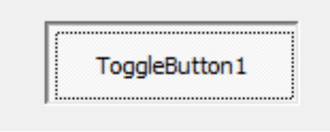
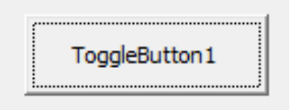
Toggle Button
Example 7: Create Toggle button in a worksheet. When the Toggle button is being depressed, it shows text “Apple” with red color in cell A1. When it is not depressed, it shows text “Orange” with blue color in cell A1.

Slide 47
Toggle Button
Toggle button lets the user switches from one action to another alternatively. When the Toggle button is being depressed, the value is true and when it is not depressed, the value is false. By using the If and Else code structure, we can thus switch from one action to another by pressing the toggle button repeatedly.
Private Sub ToggleButton1_Click()
If ToggleButton1.Value = True Then
Range("a1").Value = "Apple"
Range("A1").Font.Color = vbRed
Else
Cells(1, 1) = "Orange"
Cells(1, 1).Font.Color = vbBlue
End If
End Sub

